Slide 1
Chapter 4 Concurrency and Threads
Instructor Jianhui Yue
Spring 2017
CSE, Miami Univ.

Slide 2
Outline
Motivations for Threads(sect. 4.1)
Thread Abstraction(sect. 4.2)
Simple Thread API(sect. 4.3)
Thread Data Structure(TCB) (sect. 4.4)
Thread Life Cycle(sect. 4.5)
Implementing Kernel Threads(sect. 4.6)
Single-threaded Processes(sect. 4.7)
Multi-threaded Processes(sect. 4.8)

Slide 3
Motivation
Operating systems (and application programs) often need to be able to handle multiple things happening at the same time
Process execution, interrupts, background tasks, system maintenance
Humans are not very good at keeping track of multiple things happening simultaneously
Threads are an abstraction to help bridge this gap

Slide 4
Why Concurrency?
Servers
Multiple connections handled simultaneously
Parallel programs
To achieve better performance
Programs with user interfaces
To achieve user responsiveness while doing computation
Network and disk bound programs
To hide network/disk latency

Slide 5
How to Write a Concurrent Program?
Write a concurrent program as a set of sequential streams of execution, or thread that interact and share results
Code for each thread is sequential and threads run concurrently
OS provides the illusion of infinite number virtual processors with limited physical processors.
At any given time, only a subset of threads are running
Suspending and resuming threads

Slide 6
Outline
Motivations for Threads(sect. 4.1)
Thread Abstraction(sect. 4.2)
Simple Thread API(sect. 4.3)
Thread Data Structure(TCB) (sect. 4.4)
Thread Life Cycle(sect. 4.5)
Implementing Kernel Threads(sect. 4.6)
Single-threaded Processes(sect. 4.7)
Multi-threaded Processes(sect. 4.8)

Slide 7
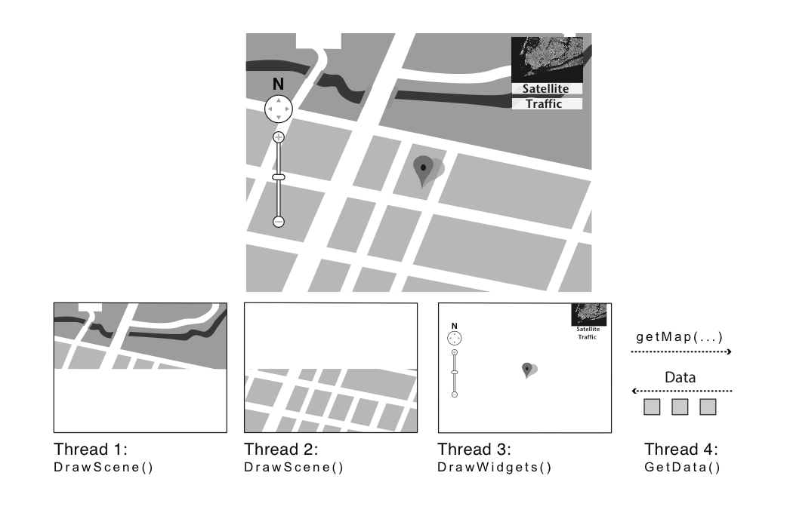
Thread Use Cases Google Earth
Multiple tasks are programmed with multiple threads.
Use threads to express concurrency.

Slide 8
Benefits to Use Threads
Simplify writing concurrent code
Maintain Responsiveness
Create a background thread for the long time task
Exploit multiple processors(performance)
Hiding slow I/O operations(performance)
Creating a I/O thread for the I/O task
Processor run a different thread when I/O thread is waiting for I/O events
Processor can still respond quickly to I/O events when working on other tasks

Slide 9
Definitions
A thread is a single execution sequence that represents a separately schedulable task
Single execution sequence: familiar programming model
Separately schedulable: OS can run or suspend a thread at any time

Slide 10
Threads in the Kernel and at User-Level
Multi-threaded kernel
multiple threads, sharing kernel data structures, capable of using privileged instructions
Multiprocess kernel
Multiple single-threaded processes
System calls access shared kernel data structures
Multiple multi-threaded user processes
Each with multiple threads, sharing same data structures, isolated from other user processes

Slide 11
Thread Abstraction
Infinite number of processors
Threads execute with variable speed
Programs must be designed to work with any schedule
Notes:
Execution model: each thread runs on a dedicated virtual processor with unpredictable and variable speed.

Slide 12
OS Run More Threads Than Physical Processors
OS provides the illusion of infinite number of processors with a limited number of physical processors.
Thread scheduler inside OS switch between threads that are running and those that are ready but not running.
Switching between threads is transparent to each thread

Slide 13
Illusion vs. Reality
Illusion: each instruction appears to execute immediately after the preceding one.
Reality: OS scheduler may suspend a thread between one instruction and the next one and resume running it later.

Slide 14
Programmer vs. Processor View
Illusion: each instruction appears to execute immediately after the preceding one.
Reality: OS scheduler may suspend a thread between one instruction and the next one and resume running it later.

Slide 15
Scheduler affects thread execution
Thread programmers should not make any assumptions about the relative speed with which different threads execute.

Slide 16
Outline
Motivations for Threads(sect. 4.1)
Thread Abstraction(sect. 4.2)
Simple Thread API(sect. 4.3)
Thread Data Structure(TCB) (sect. 4.4)
Thread Life Cycle(sect. 4.5)
Implementing Kernel Threads(sect. 4.6)
Single-threaded Processes(sect. 4.7)
Multi-threaded Processes(sect. 4.8)

Slide 17
Thread Operations
thread_create(thread, func, args)
Create a new thread to run func(args)
thread_yield()
Relinquish processor voluntarily
thread_join(thread)
In parent, wait for forked thread to exit, then return
thread_exit
Quit thread and clean up, wake up joiner if any
Notes:
UNIX fork and thread fork are not the same thing

Slide 18
Example: threadHello
#define NTHREADS 10
thread_t threads[NTHREADS];
main() {
for (i = 0; i < NTHREADS; i++) thread_create(&threads[i], &go, i);
for (i = 0; i < NTHREADS; i++) {
exitValue = thread_join(threads[i]);
printf("Thread %d returned with %ld\n", i, exitValue);
}
printf("Main thread done.\n");
}
void go (int n) {
printf("Hello from thread %d\n", n);
thread_exit(100 + n);
// REACHED?
}

Slide 19
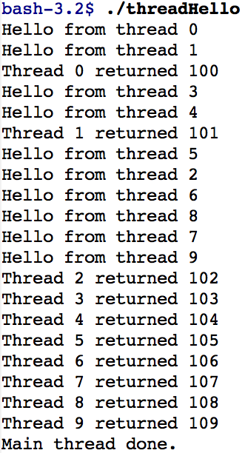
threadHello: Example Output
Why must “thread returned” print in order?
What is maximum # of threads running when thread 5 prints hello?
Minimum?

Slide 20
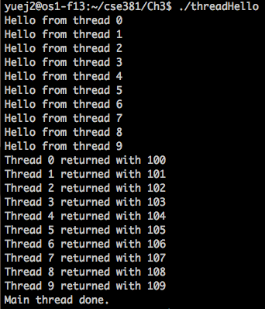
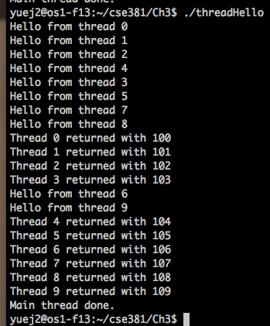
Two Extra Executions

Slide 21
Fork/Join Concurrency
Threads can create children, and wait for their completion
Data only shared before fork/after join
Examples:
Web server: fork a new thread for every new connection
As long as the threads are completely independent
Merge sort
Parallel memory copy

Slide 22
bzero with fork/join concurrency
void blockzero (unsigned char *p, int length) {
int i, j;
thread_t threads[NTHREADS];
struct bzeroparams params[NTHREADS];
// For simplicity, assumes length is divisible by NTHREADS.
for (i = 0, j = 0; i < NTHREADS; i++, j += length/NTHREADS) {
params[i].buffer = p + i * length/NTHREADS;
params[i].length = length/NTHREADS;
thread_create_p(&(threads[i]), &go, &params[i]);
}
for (i = 0; i < NTHREADS; i++) {
thread_join(threads[i]);
}
}

Slide 23
Outline
Motivations for Threads(sect. 4.1)
Thread Abstraction(sect. 4.2)
Simple Thread API(sect. 4.3)
Thread Data Structure(TCB) (sect. 4.4)
Thread Life Cycle(sect. 4.5)
Implementing Kernel Threads(sect. 4.6)
Single-threaded Processes(sect. 4.7)
Multi-threaded Processes(sect. 4.8)

Slide 24
Thread Data Structures
Each thread has its state info for the saving/restoring state caused by thread switch.(Thread Control Block)
The state of the computation being performed by the thread
Metadata about it for the management purpose.
Some state is shared among threads running the same process or OS kernel.
(Code, Global variables, heap)

Slide 25
Thread Control Block(TCB)
Stack
Store information needed by the nested procedures the thread is currently running
Different threads can have different procedures called with different para. and each thread need its own stack
Copy of processor registers
Both general registers and some special-purpose registers (pc, sp)
Used for stat info saving and restore (caused by thread switch)
Metadata(info for managing the thread)
Thread ID, scheduling priority, status

Slide 26
Outline
Motivations for Threads(sect. 4.1)
Thread Abstraction(sect. 4.2)
Simple Thread API(sect. 4.3)
Thread Data Structure(TCB) (sect. 4.4)
Thread Life Cycle(sect. 4.5)
Implementing Kernel Threads(sect. 4.6)
Single-threaded Processes(sect. 4.7)
Multi-threaded Processes(sect. 4.8)

Slide 27
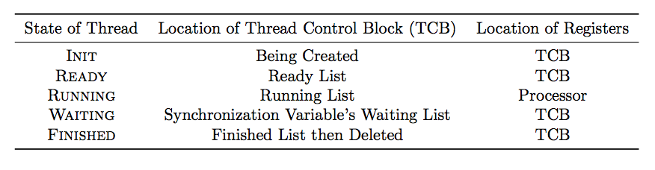
Thread Lifecycle
Ready list
Running list
Finished list
Waiting lists
Notes:
Labels should be thread_create() not sthread_create, etc.

Slide 28
Create Thread
Ready list
TCB
Init: OS puts the thread its INIT state and allocate TCB
Ready: OS puts the thread to ready list and put it to ready sate
Ready list: the set of runnable thread waiting for CPU

Slide 29
Ready
Ready list
Running list
A thread in the ready state is available to run but is not currently running.
Thread TCB is in ready list and values of registers are stored in TCB
OS transitions a thread from ready to running at any time

Slide 30
Running
Ready list
Running list
A thread in running state in running on a CPU.
Transition to ready state
Scheduler preempts the thread and puts it ready list
1) save stat to TCB 2) switch the CPU to run the next one in ready list
A running thread can voluntarily give up CPU an go to READY by calling yield
Many transitions from READY to running

Slide 31
Waiting
Ready list
Running list
Finished list
TCB
TCB
Waiting lists
A thread in the waiting state is waiting for some event.
A waiting thread’s TCB is put in the waiting list
On occurrence of the event, OS moves the waiting thread from waiting list to ready list

Slide 32
Finished
Finished list
A thread in the finished state never run again.
OS frees some or all of its resource and puts it in finished list.
After its state is not needed, it is deleted.

Slide 33
Outline
Motivations for Threads(sect. 4.1)
Thread Abstraction(sect. 4.2)
Simple Thread API(sect. 4.3)
Thread Data Structure(TCB) (sect. 4.4)
Thread Life Cycle(sect. 4.5)
Implementing Kernel Threads(sect. 4.6)
Single-threaded Processes(sect. 4.7)
Multi-threaded Processes(sect. 4.8)

Slide 34
Implementing Threads: Roadmap
Kernel threads
Thread abstraction only available to kernel
To the kernel, a kernel thread and a single threaded user process look quite similar
Multithreaded processes using kernel threads (Linux, MacOS)
Kernel thread operations available via syscall
User-level threads
Thread operations without system calls

Slide 35
Multithreaded OS Kernel

Slide 36
Creating a Thread
Goal: perform an asynchronous procedure call to func with arg
On thread running, it will execute func(arg) concurrently with the calling thread
Allocate a TCB
Initialize per-thread state
Initialize registers
The constructor starts the thread in Stub function
The stub can make the func( ) return only to the stub rather than arbitrary location in memory.
Put TCB on ready list

Slide 37
Why Stub?
Consider the case thread terminate itself by using return rather than thread_exit( ).
When the processor executes return, it will pop a break-point from stack to the pc.
What data are stored at thread stack at this time point? Nothing.
In to avoid the above situation, we need a stub to call thread_exit( ).

Slide 38
Implementing threads
Thread_creat(func, args)
Allocate thread control block
Allocate stack
Build stack frame for base of stack (stub)
Put func, args on stack
Put thread on ready list
Will run sometime later (maybe right away!)
stub(func, args):
Call (*func)(args)
If return, call thread_exit()

Slide 39
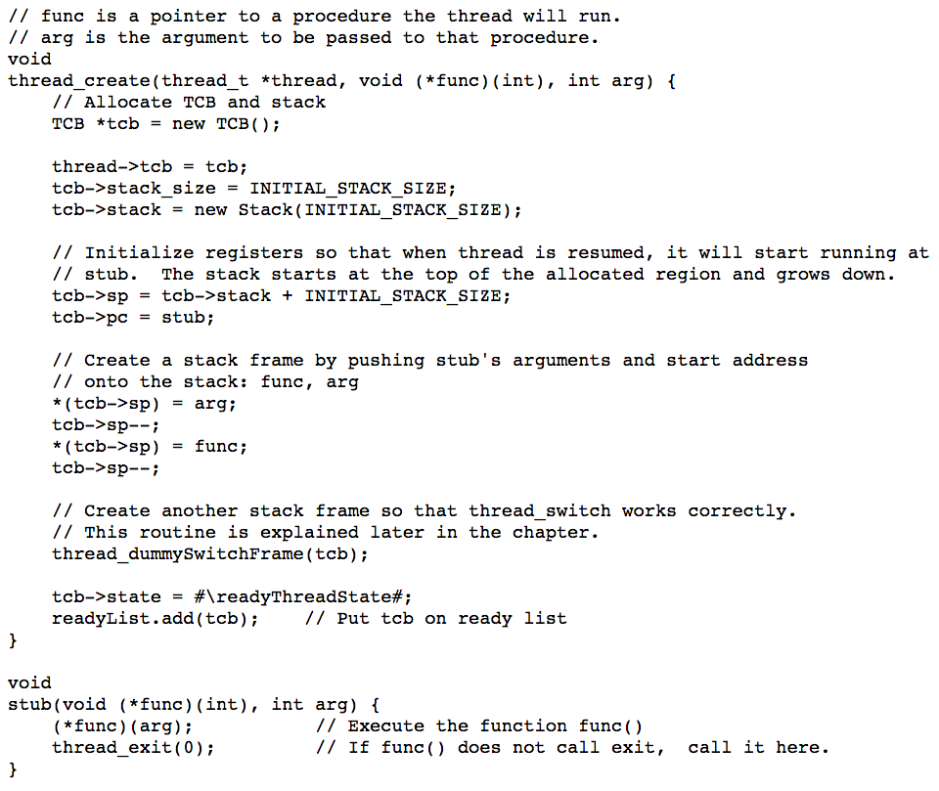

Slide 40
Deleting a Thread
Remove it from the ready list
Free its pre-thread state
Freeing the state is tricky
Interrupt handler running causes problem before releasing the state is done.
On exit, thread is put to Finished state and is moved to finished list.
Its state is safely released by other thread

Slide 41
Thread Context Switch
A thread context switch suspends execution of a currently running thread and resumes execution of some other thread.
It saves running thread’s registers to the TCB and stack and restores the new thread’s registers from that thread’s TCB and stack to CPU.

Slide 42
What cause context switch?
Voluntary (Caused by the running thread itself)
Calling thread lib functions
Voluntarily give up processor
Thread_yield( )
Thread_join ( ) (if child is not done yet)
Involuntary( Caused by external events)
Interrupt or exception
After the handler is done, scheduler switch to some other thread is higher priority
Hardware timer to implement fair sharing CPU
Involuntary context switch makes thread execution with unpredictable and variable speed.

Slide 43
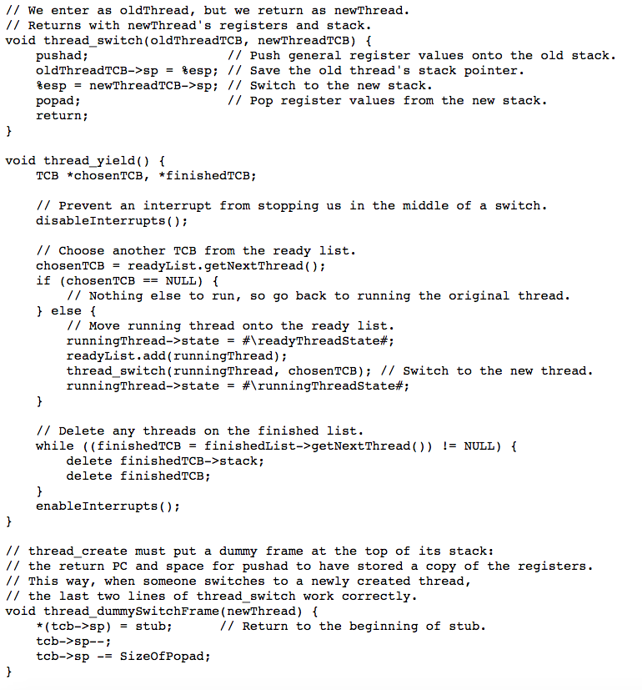

Slide 44
Question
1 Draw TCB for thread A and thread B after OS executes thread_swtich( threadA, threadB)
2 Assume thread B is newly created without executing any instructions.
Repeat the 1 when thread_creat( ) does NOT execute thread_dummySwitchFrame( ) for thread B.
Repeat the 1 when thread_creat( ) does execute thread_dummySwitchFrame( ) thread B.

Slide 46
Example
Suppose two threads each loop, calling thread_yeild( ) on each iteration.
What is the sequence of steps as seen by the physical processor and by each thread?
Go( ){
while( 1 ){
thread_yield( );
}
}

Slide 47
Two Threads Call Yield

Slide 48
Involuntary Thread/Process Switch
Timer or I/O interrupt
Tells OS some other thread should run
Simple version
End of interrupt handler calls switch()
When resumed, return from handler resumes kernel thread or user process
Thus, processor context is saved/restored twice (once by interrupt handler, once by thread switch)

Slide 49
Outline
Motivations for Threads(sect. 4.1)
Thread Abstraction(sect. 4.2)
Simple Thread API(sect. 4.3)
Thread Data Structure(TCB) (sect. 4.4)
Thread Life Cycle(sect. 4.5)
Implementing Kernel Threads(sect. 4.6)
Single-threaded Processes(sect. 4.7)
Multi-threaded Processes(sect. 4.8)

Slide 50
Single-threaded user process
Each Process has its thread
Process has its own memory, code, heap, and global variables.
Kernel ready list contains both thread and process
Process context switch
Similar to thread switch

Slide 51
Outline
Motivations for Threads(sect. 4.1)
Thread Abstraction(sect. 4.2)
Simple Thread API(sect. 4.3)
Thread Data Structure(TCB) (sect. 4.4)
Thread Life Cycle(sect. 4.5)
Implementing Kernel Threads(sect. 4.6)
Single-threaded Processes(sect. 4.7)
Multi-threaded Processes(sect. 4.8)

Slide 52
Implement multi-thread process using kernel threads
1 A thread has a user stack and a TCB
2 Create thread
The user library create the user stack before invoking system call to create the kernel thread, which creates the kernel stack.
3 Put the thread to ready list to run it after being created

Slide 53
Implementing user-level threads without kernel support
Pure use-level thread minimizes dependencies on the specific OS and has good portability.(JVM)( it is also referred as green thread)
Create and manage the ready, waiting, finished lists in the user process space.
The green threads is a single-threaded process for the kernel.
OS is unaware of the state of the user-level ready list.( A I/O request can block all threads in the same process)
Using the signal handler to implement preemptive user-level thread

